Slide 1

CS302 Design and Analysis of Algorithms
Muhammad sohail afzal

Slide 2
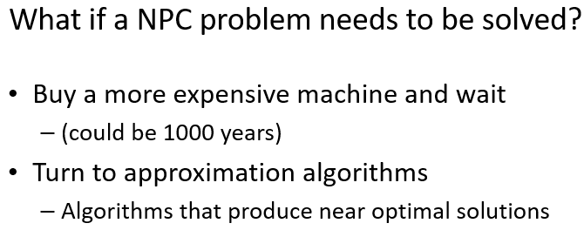
Approximate Algorithms for NPC Problems

Slide 3
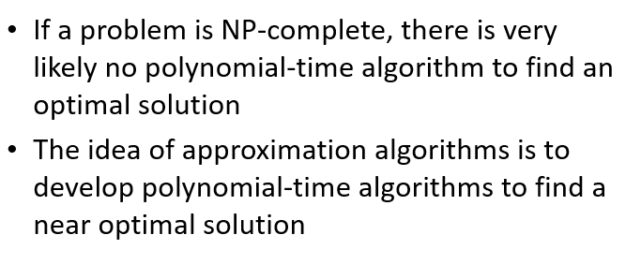
Approximate Algorithms for NPC Problems

Slide 4
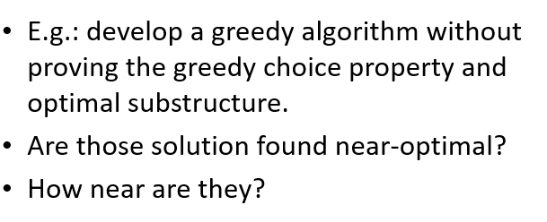
Approximate Algorithms for NPC Problems

Slide 5
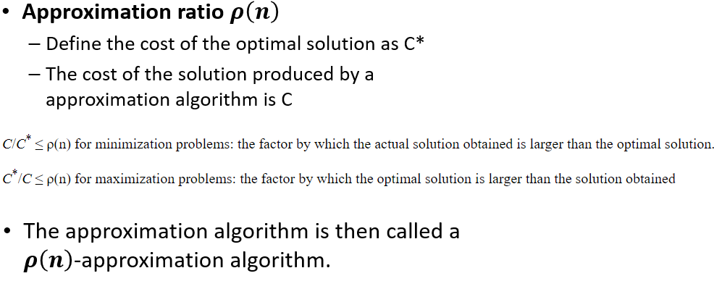
Approximate Algorithms for NPC Problems

Slide 6
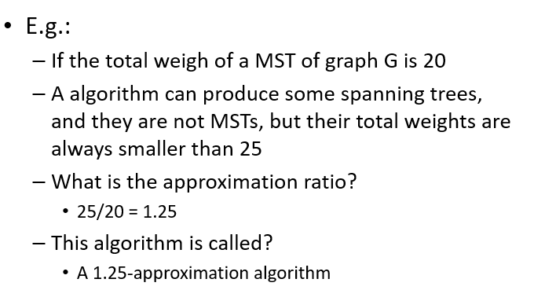
Approximate Algorithms for NPC Problems

Slide 7
Approximate Algorithms for NPC Problems
MST is minimization problem as we need to minimize distance so approximate ratio = C/C*
Maximization problem is problem where we need to maximize something like robot maximize reward question given in mid2 where we need to maximize reward unlike MST. In that case, approximate ratio = C*/C
In short approximate ratio will be greater than 1 as approximate algorithm is near optimal which means it is not better than optimal.

Slide 8
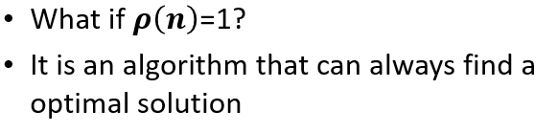
Approximate Algorithms for NPC Problems

Slide 9
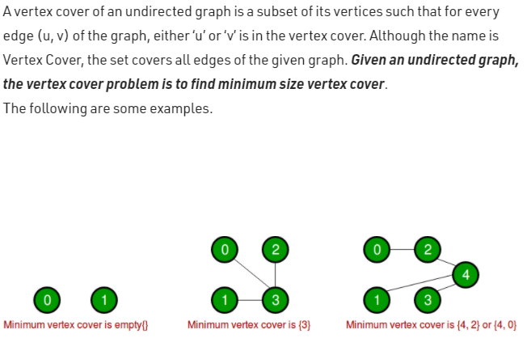
2-approximation algorithm for Vertex Cover
A 2-approximation algorithm returns a solution whose cost is at most twice the optimal
Vertex Cover Problem (NP-Complete Problem) :

Slide 10
2-approximation algorithm for Vertex Cover
1
2
3
4
5
6
7
Are the dark brown vertices a vertex-cover?
No. why?
Edges (5, 6), (3, 6) and (3, 7) are not covered by it

Slide 11
2-approximation algorithm for Vertex Cover
1
2
3
4
5
6
7
Are the dark brown vertices a vertex-cover?
No. why?
Edge (3, 7) is not covered by it

Slide 12
2-approximation algorithm for Vertex Cover
1
2
3
4
5
6
7
Are the dark brown vertices a vertex-cover?
Yes
What is the size?
4

Slide 13
2-approximation algorithm for Vertex Cover
1
2
3
4
5
6
7
Are the dark brown vertices a vertex-cover?
Yes
What is the size?
7

Slide 14
2-approximation algorithm for Vertex Cover
1
2
3
4
5
6
7
Are the dark brown vertices a vertex-cover?
Yes
What is the size?
5

Slide 15
2-approximation algorithm for Vertex Cover
1
2
3
4
5
6
7
Are the dark brown vertices a vertex-cover?
Yes
What is the size?
3

Slide 16
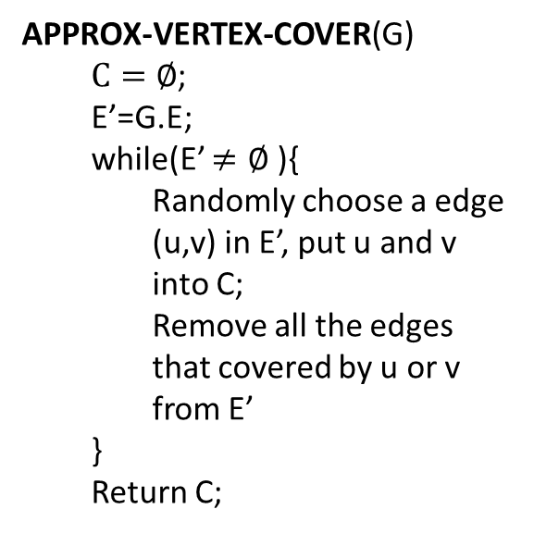
2-approximation algorithm for Vertex Cover
APPROX-VERTEX-COVER(G)
$C=∅$;
E’=G.E;
while(E’ $≠∅$ ){
Randomly choose a edge (u,v) in E’, put u and v into C;
Remove all the edges that covered by u or v from E’
}
Return C;
1
2
3
4
5
6
7

Slide 17
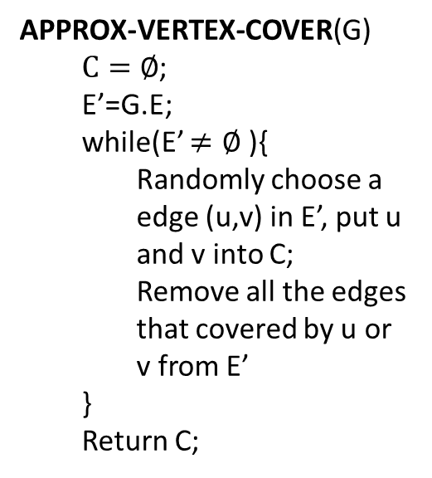
2-approximation algorithm for Vertex Cover
APPROX-VERTEX-COVER(G)
$C=∅$;
E’=G.E;
while(E’ $≠∅$ ){
Randomly choose a edge (u,v) in E’, put u and v into C;
Remove all the edges that covered by u or v from E’
}
Return C;
1
2
3
4
5
6
7
It is then a vertex cover
Approximate cost / optimal cost = 6/3 = 2
Size?
6
How far from optimal one?

Slide 18
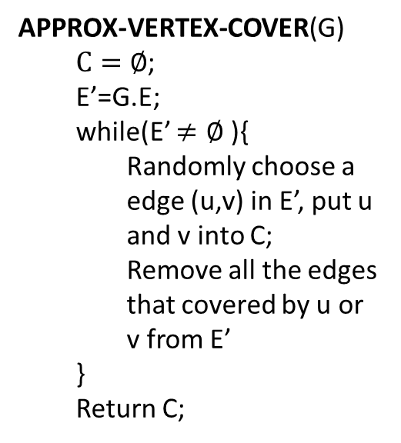
2-approximation algorithm for Vertex Cover
APPROX-VERTEX-COVER(G)
$C=∅$;
E’=G.E;
while(E’ $≠∅$ ){
Randomly choose a edge (u,v) in E’, put u and v into C;
Remove all the edges that covered by u or v from E’
}
Return C;
1
2
3
4
5
6
7

Slide 19
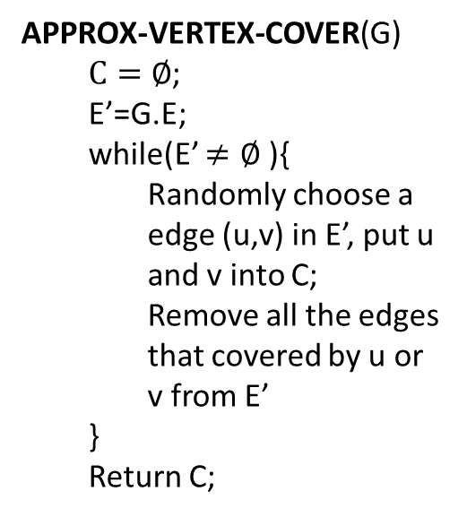
2-approximation algorithm for Vertex Cover
APPROX-VERTEX-COVER(G)
$C=∅$;
E’=G.E;
while(E’ $≠∅$ ){
Randomly choose a edge (u,v) in E’, put u and v into C;
Remove all the edges that covered by u or v from E’
}
Return C;
1
2
3
4
5
6
7
It is then a vertex cover
Size?
4
How far from optimal one?
4/3 = 1.33

Slide 20
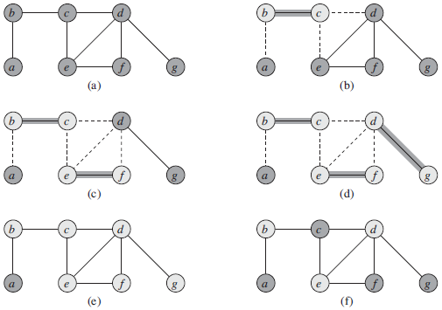
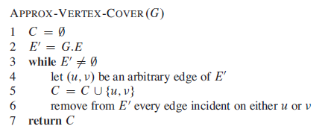
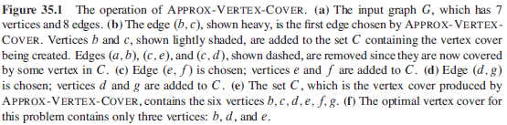
2-approximation algorithm for Vertex Cover

Slide 21
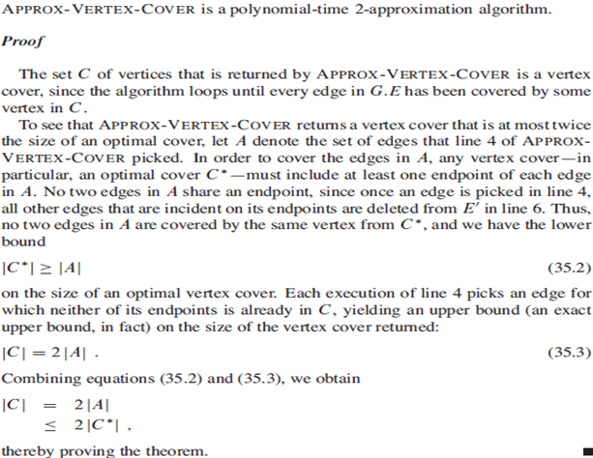
2-approximation algorithm for Vertex Cover

Slide 22

Approximation algorithm for Set-covering problem
Set-covering problem
Given a set X, and a family F of subsets of X, where F covers X, i.e. $X=\bigcup_{S∈F}{S}$.
Find a subset of F that covers X and with minimum size

Slide 23
Approximation algorithm for Set-covering problem
X:
a
b
c
h
d
e
{f1, f3, f4} is a subset of F covering X
F:
{f1, f2, f3, f4} is a subset of F covering X
f1:
a
b
f5:
a
{f2, f3, f4, f5} is a subset of F covering X
f2:
b
f3:
c
h
Here, {f1, f3, f4} is a minimum cover set
f4:
d
e

Slide 24

Approximation algorithm for Set-covering problem
Set-covering problem is NP-complete.
If the size of the largest set in F is m, there is a $\sum_{i=1}^{m}{1/i}$ - approximation polynomial time algorithm to solve it.

Slide 25

Approximation algorithm for Set-covering problem
GREEDY-SET-COVER(X, F)
U=X;
C=$∅;$
While(U$≠$ $∅$){
Select S$∈$F that maximizes |S$∩$U|;
U=U-S;
C=C$⋃${S};
}
return C;

Slide 26
Approximation algorithm for Set-covering problem
We can choose from f1, f3 and f4
X:
Choose f1
a
b
c
h
We can choose from f3 and f4
Choose f3
We can choose from f4
d
e
Choose f4
F:
f1:
a
b
a
b
c
h
d
e
U:
f2:
b
f3:
c
h
C:
f1:
a
b
f4:
d
e
f3:
c
h
f5:
a
f4:
d
e

Slide 27
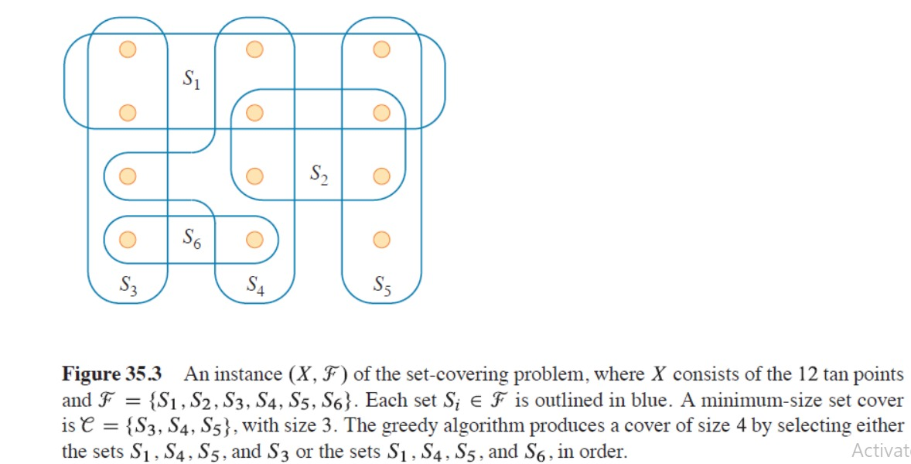
Approximation algorithm for Set-covering problem
In this example, set cover approx solution is not optimal…

Slide 28
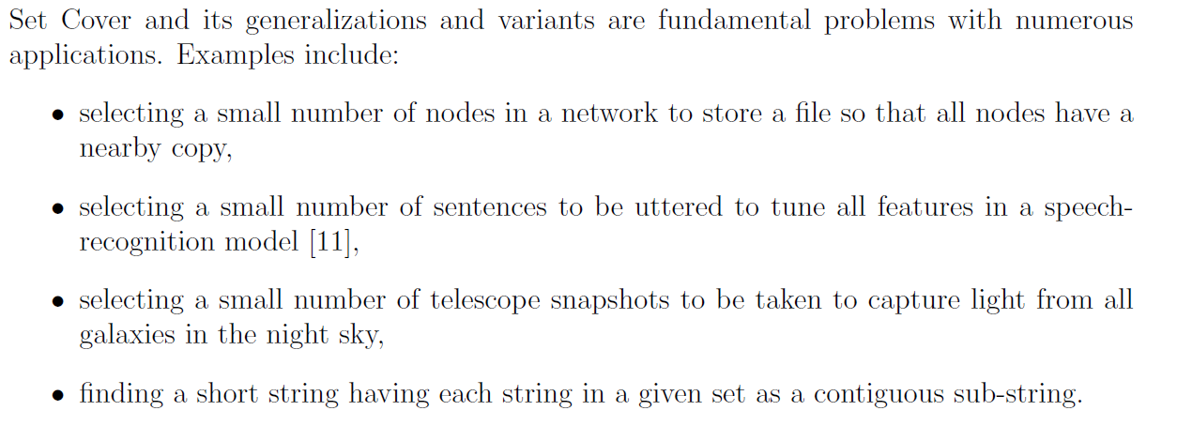
Approximation algorithm for Set-covering problem

Slide 29
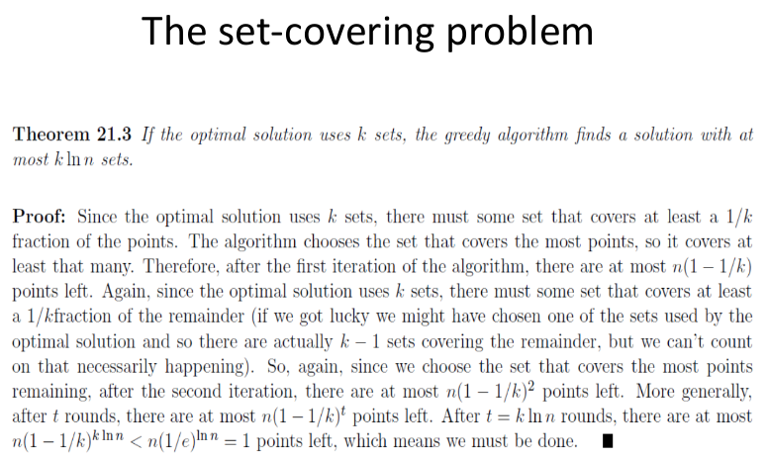
Approximation algorithm for Set-covering problem

Slide 30
Approximation algorithm for Traveling-salesman problem
Traveling-salesman problem (TSP):
Given a weighted, undirected graph, start from certain vertex, find a minimum route visit each vertices once, and return to the original vertex.
1
1
2
30
2
1
20
3
4
3

Slide 31
Approximation algorithm for Traveling-salesman problem
TSP is a NP-complete problem
There is no polynomial-time approximation algorithm with a constant approximation ratio
Another strategy to solve NPC problem:
Solve a special case

Slide 32
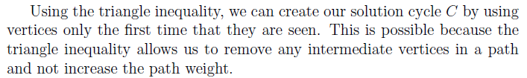
Approximation algorithm for Traveling-salesman problem
Triangle inequality:
Weight(u, v) <= Weight(u, w) + Weight(w, v)
E.g.:
If all the edges are defined as the distance on a 2D map, the triangle inequality is true
For the TSPs where the triangle inequality is true:
There is a 2-approximation polynomial time algorithm

Slide 33
Approximation algorithm for Traveling-salesman problem
APPROX-TSP-TOUR(G)
Find a MST m;
Choose a vertex as root r;
return preorderTreeWalk(m, r);

Slide 34
Approximation algorithm for Traveling-salesman problem
Can we apply the approximation algorithm on this one?
1
1
2
30
2
1
20
3
4
3
No. The triangle inequality is violated.

Slide 35
Approximation algorithm for Traveling-salesman problem
Use Prim’s algorithm to get a MST
a
d
e
b
f
g
c
h
For any pair of vertices, there is a edge and the weight is the Euclidean distance
Triangle inequality is true, we can apply the approximation algorithm

Slide 36
Approximation algorithm for Traveling-salesman problem
Use Prim’s algorithm to get a MST
a
d
Choose “a” as the root
e
b
f
g
Preorder tree walk
c
a
b
c
h
d
e
f
g
h
For any pair of vertices, there is a edge and the weight is the Euclidean distance
Triangle inequality is true, we can apply the approximation algorithm

Slide 37
Approximation algorithm for Traveling-salesman problem
Use Prim’s algorithm to get a MST
a
d
Choose “a” as the root
e
b
f
g
Preorder tree walk
c
a
b
c
h
d
e
f
g
h
The route is then…
Because it is a 2-approximation algorithm
A TSP solution is found, and the total weight is at most twice as much as the optimal one

Slide 38
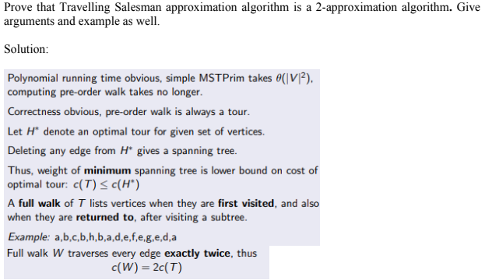
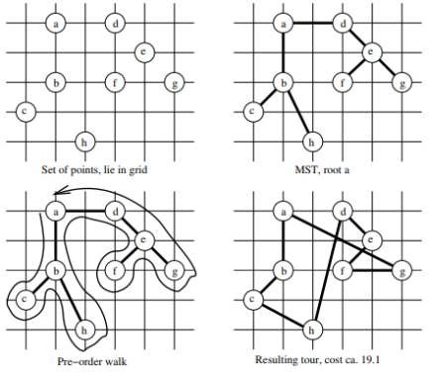
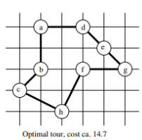
Approximation algorithm for Traveling-salesman problem

